Slide 1


Systems and Methods for Image Encryption Using Steganography and XOR Operations
Soham Sachin Nimale (Corresponding & Presenting Author)
DEPARTMENT OF ENGINEERING SCIENCES AND HUMANITIES (DESH)
VISHWAKARMA INSTITUTE OF TECHNOLOGY, PUNE

Slide 2
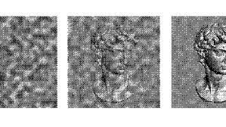
Table of Contents
Systems and Methods for Image Encryption Using Steganography and XOR Operations
Introduction
Literature review
Feature Extraction
Presented System
System Flow Diagram
Stepwise Example
Results & Discussions
Conclusion
Source: https://www.theengineer.co.uk/content/news/steganography-algorithms-enable-perfectly-secure-information/

Slide 3
Introduction
Systems and Methods for Image Encryption Using Steganography and XOR Operations
Billions of images are generated every year and shared across various networks.
To prevent unauthorized access to these images, proper encryption and decryption is very important.
We will take a look at XOR operations based optical encryption-decryption, followed by Steganography and RSA encryption for image properties.
Source:
(Output of Optical encryption using our system for the image: https://picryl.com/media/1963-11-1963-6331ff)

Slide 4
Literature Review
Important Points From Literature Review
For Encryption, longer the key better the security as more the computation needed to get the exact key, but longer the time needed for encryption.
The main difference between the encryption of image and text is that some error in the decrypted image is acceptable since the human eye cannot detect such small changes.
For such image-based encryption algorithms, the modified image must be super sensitive to the value of the key; little change in the value of the key must correspond to a high magnitude of disturbance in the image so that it is harder to find the correct key.
We use RSA for generating public and private keys. The Use of two different keys for encryption and decryption is called Asymmetric cryptography.
The use of asymmetric keys is generally very time-consuming compared to symmetric keys but preferred because only the receiver has the private key capable of decrypting the encrypted image.

Slide 5
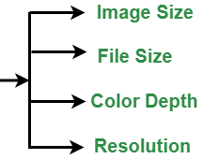
Feature Extraction
Integration of various features from different algorithms into a integrated system
XOR operations for optical encryption for faster results so more time can be spent in RSA and Steganography.
RSA for key generation, for the encryption of image properties.
The image properties used as “Input Parameters” for the steganography and XOR encryption layers are needed for decryption purpose.
Thus, securing these Input Parameters make the decryption of Steganography and Optical Encryption very difficult to compute using brute force.

Slide 6
Presented System
Steps Involved in the final system
Optical Encryption – Out of various scan based XOR optical encryption, we choose an Raster Scan based one where each bit is XOR with the next bit. The image is assumed to be a 1-Dimensional array of bits from the top-left corner of the image as the start point and the bottom-right corner as the terminal point of the array of bits while doing the encryption. The First bit of image is needed for the decryption and can thus encrypted using the RSA algorithm as one of the image parameters or simply put in a secret part of image that both the end users agree with.
Steganography – We make use of LSB based distributed steganography where we use modular arithmetic for an even distribution of pixels of hidden image in the Top Layer of steganography. We also use pseudo-random pixels for “Garbage” bits to ensure the steganography is hard to decrypt.
RSA Encryption of Image Parameters – We make use of 512 bit long key for the encryption of image parameters like image height, width, colour-depth, etc.

Slide 7
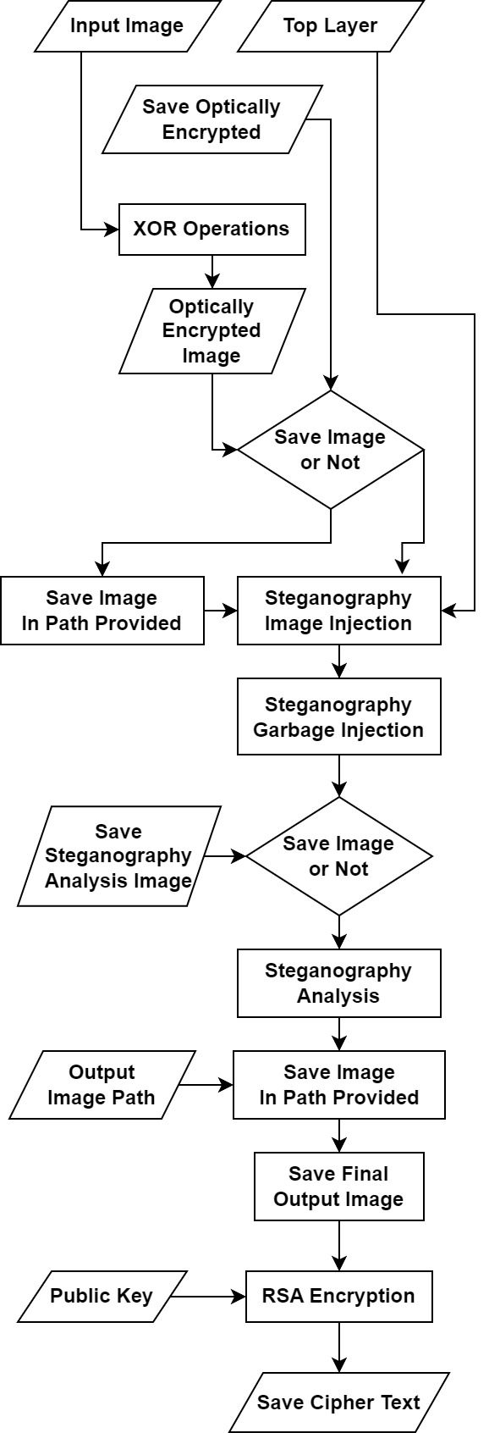
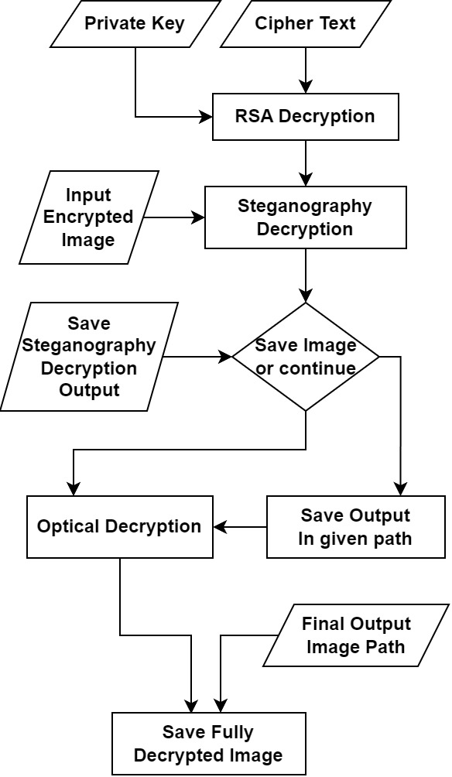
System Flow Diagram
Flowchart 1: Encryption flow
Flowchart 2: Decryption flow
1
2

Slide 8
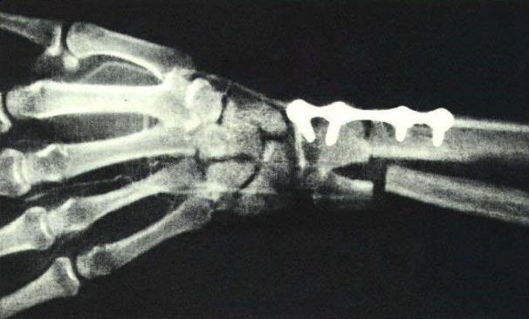
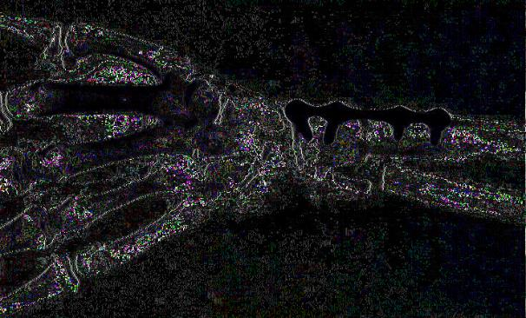
Stepwise Example
Optical Encryption
Public Domain Image Source: https://picryl.com/media/1963-11-1963-6331ff

Slide 9
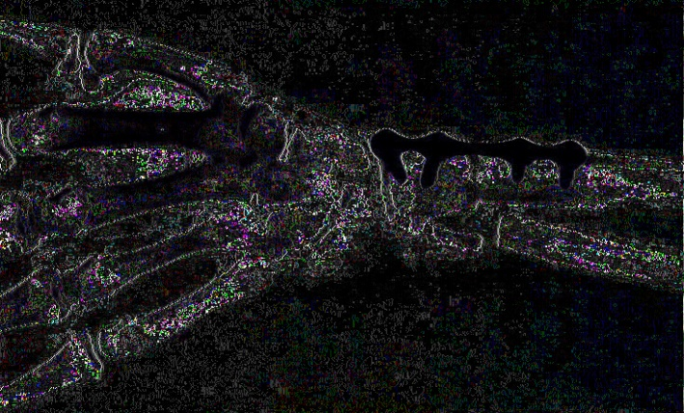


Stepwise Example
Steganography
Source: https://wall.alphacoders.com/big.php?i=735066

Slide 10
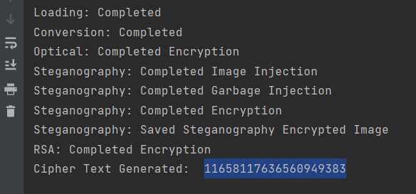
Stepwise Example
RSA Encryption

Slide 11


Results and Discussion
Steganography analysis output using simple LSB-based steganography. The black pixels at the top of the figure represent the detected bit sequence of the input image. The grey pixels represent the unused pixels of the Top Layer Image.
Steganography analysis output for random constant distance between bit-sequence of the input image while injecting into the Top Layer. The black pixels at the top of the figure represent the detected bit sequence of the input image. The small layer of white pixels at the bottom of the analysis image represents the unused pixels of the Top Layer Image.

Slide 12


Contd.
Steganography analysis output for the same algorithm used in Fig. 6., but for a different Top Layer image. The black pixels at the top of the figure represent the detected bit sequence of the input image. The white pixels at the bottom of the figure represent the unused pixels of the Top Layer Image.
Steganography analysis output for the perfect maximum distance method implemented along with garbage bit injection. The black pixels in the figure represent the detected bit sequence of the input image. The white pixels represent the unused pixels of the Top Layer image.

Slide 13
Contd.
Using RSA on image pixels is unviable, thus image properties is preferred.
For speeding up steganography, once the perfect distance of spread is found for the injection of original image in the Top layer, parallel processing used.
Analysis of steganography can also be done in the presented system, where user can determine to what extent the steganography worked.
XOR based encryption seem to perform well on integration with Steganography. Also because of the less computation time.

Slide 14
Conclusion
Thus, a system for image encryption-decryption was obtained with the integration of XOR operations, Steganography and RSA algorithm. Each method was fine tuned to work together to produce the best results.
REFERENCES
[1]Nilesh Uke, “Healthcare 4.0 enabled lightweight security provisions for medical data processing.” Turkish Journal of Computer and Mathematics Education (TURCOMAT) doi: 10.17762/turcomat.v12i11.5858
[2]14Millán, María & Pérez-Cabré, Elisabet. (2011). Optical Data Encryption. Optical and digital image processing: fundamentals and applications. 739-767. 10.1002/9783527635245.ch33.
[3]Moradi Rad, Reza & Attar, Abdolrahman & Ebrahimi Atani, Reza. (2013). A new fast and simple image encryption algorithm using scan patterns and XOR. International Journal of Signal Processing, Image Processing and Pattern Recognition. 6. 275-290. 10.14257/ijsip.2013.6.5.25.
[4]Mohammed, Abdalbasit & Varol, Nurhayat. (2019). A review paper on cryptography. 1-6. 10.1109/ISDFS.2019.8757514.
[5]Agrawal, Ekta & Pal, Parashu. (2017). A secure and fast approach for encryption and decryption of message communication. International Journal of Engineering Science and Computing. 7. 5.
[6]Xin Zhou and Xiaofei Tang, "Research and implementation of RSA algorithm for encryption and decryption," Proceedings of 2011 6th International Forum on Strategic Technology, Harbin, Heilongjiang, 2011, pp. 1118-1121, doi: 10.1109/IFOST.2011.6021216.
[7]Khyioon, Zainab & Hussein AL-Qinani, Iman & Neamah, Farah. (2019). Subject Review : Key generation in different cryptography algorithm. International Journal of Scientific Research in Science, Engineering and Technology. 230-240. 10.32628/IJSRSET196550.
[8]Hamid, N., Yahya, A., Ahmad, R.B. and Al-Qershi, O.M., 2012. Image steganography techniques: an overview. International Journal of Computer Science and Security (IJCSS), 6(3), pp.168-187.
[9]C.C. Chang, J.Y. Hsiao, C.S. Chen, Finding optimal least-significant-bit substitution in image hiding by dynamic programming strategy, Pattern Recognition 36 (2003) 1583–1595.
[10]EL-Emam, N. N. (2007). Hiding a large amount of data with high security using steganography algorithm. Journal of Computer Science, 3(4), 223-232. https://doi.org/10.3844/jcssp.2007.223.232
[11]Chandramouli, Rajarathnam & Memon, Nasir. (2001). Analysis of LSB based image steganography techniques. 3. 1019 - 1022 vol.3. 10.1109/ICIP.2001.958299.
[12]N. Akhtar, P. Johri and S. Khan, "Enhancing the security and quality of LSB based image steganography," 2013 5th International Conference and Computational Intelligence and Communication Networks, Mathura, India, 2013, pp. 385-390, doi: 10.1109/CICN.2013.85.
[13]Liestyowati, Dwi. (2020). Public key cryptography. Journal of Physics: Conference Series. 1477. 052062. 10.1088/1742-6596/1477/5/052062.
[14]Dar, Zain. (2018). The Pigeonhole principle and it's applications. 10.13140/RG.2.2.26177.45923.
[15]S N Uke, A R Mahajan and R C Thool. Article: UML Modeling of Physical and Data Link Layer Security Attacks in WSN. International Journal of Computer Applications 70(11):25-28, May 2013

Slide 15
Thank you

